Slide 1


IBM Maximo and Watsonx Orchestrate
AI enhanced asset management
Nigel T. Crowther
IBM Tech Sales UKI
Notes:
1

Slide 2
Overview of Maximo and Watsonx Orchestrate
IBM Maximo is an enterprise asset management solution helping organisations manage their assets: equipment, facilities, and vehicles.
IBM Watsonx Orchestrate is an AI-powered platform using natural language to automate business tasks by connecting to AI agents

Slide 3



“Our users are in Maximo all day long finding information and creating reports. Anything that would reduce that time would be a big win.”
The Problem
“We have legal and contractual maintenance documents stored in our repository, but it’s almost impossible to get the right answer without a lot of manual searching”
”We have people manually entering information collected from documents.”

Slide 4
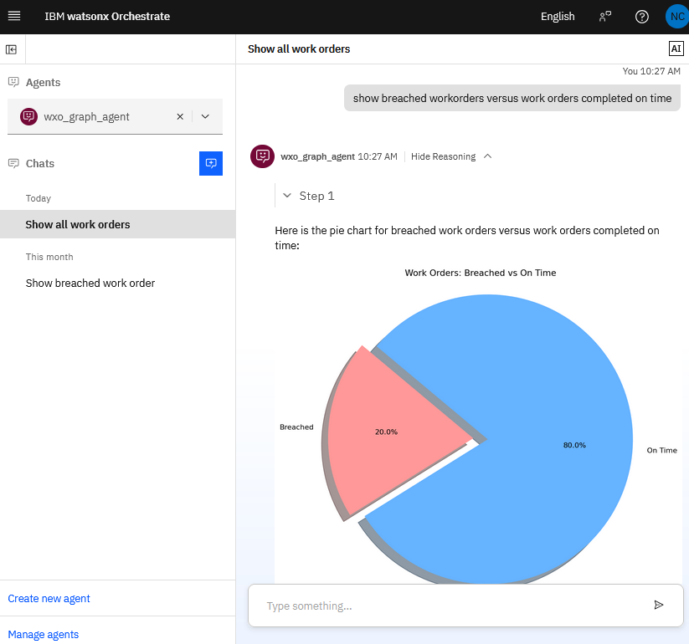
The Value
Make sense of Data
Understand Contracts
Reduce Manual Tasks
The integration of Maximo and Watsonx Orchestrate bridges the gap between asset management and agentic AI:
Use agentic AI natural language to interrogate Maximo data and create reports
Save time getting answers related to contracts.
Automate tedious data entry using Orchestrate to automate data capture and entry
IBM AI Productivity | © 2025 IBM Corporation

Slide 5



“Our users need to find the information they need in a quick and controlled manner.”
“Automating Maximo data entry reduces errors and allows our staff to get on with more valuable tasks.”
“Using AI to query legal contracts is a huge time saver.”

Slide 6

Video
YouTube Video
Git Repo
https://github.com/ncrowther/wxo-maximo
Notes:
IBM Automation overview presentation.
Make technology lifecycle management your advantage—with AI-powered automation

